Slide 1
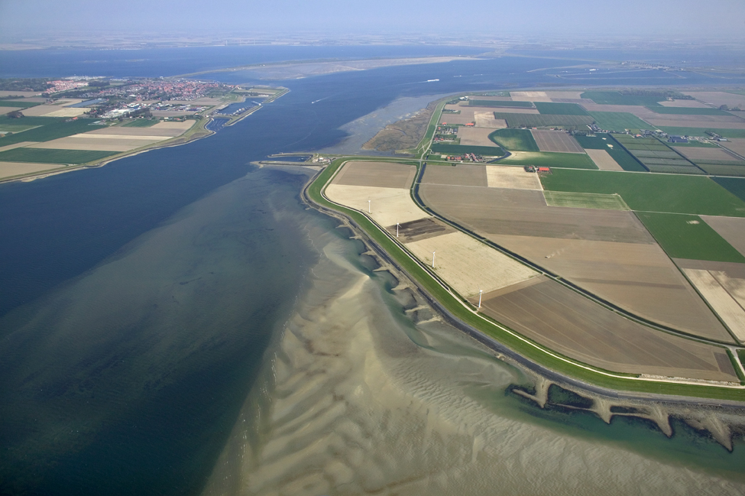

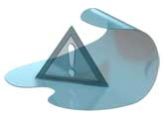
Delft-FEWS
Basic Configuration Course
(continued)

Slide 2
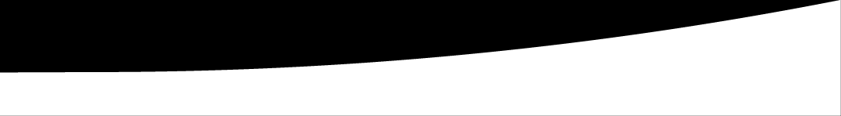

Processing data

Slide 3
Data processing
Data import
Pre-processing (transformations)
Pre-processing of model input
Post-processing of model output
Pre-adapter
Run model
Post-adapter
Post-processing
Visualisation

Slide 4
TransformationModule
Data processing can be done using the transformationModule in FEWS.
This transformationModule contains a wide range of functionality
relevent to this.
Some examples:
User transformations: simple data manipulation (A+B, etc)
Data interpolation and extrapolation (spatially and temporally)
Aggregation and disaggregation
Statistics
And much more…
http://publicwiki.deltares.nl/display/FEWSDOC/20+Transformation+Module+%28Improved+schema%29

Slide 5
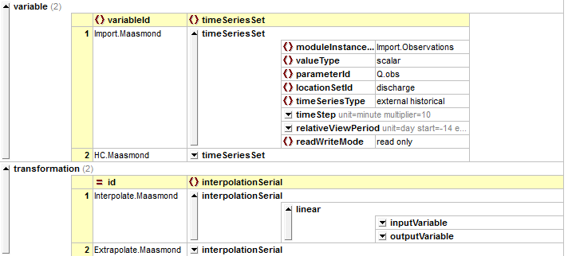
TransformationModule
Basic structure:
Input and output
variables
Transformations

Slide 6
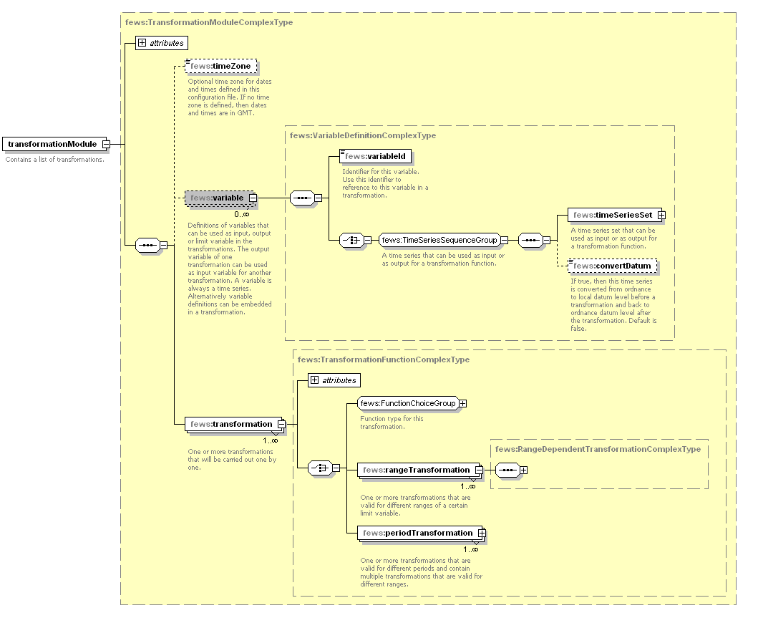
Transformation - Configuration
https://publicwiki.deltares.nl/display/FEWSDOC/20+Transformation+Module+%28Improved+schema%29

Slide 7
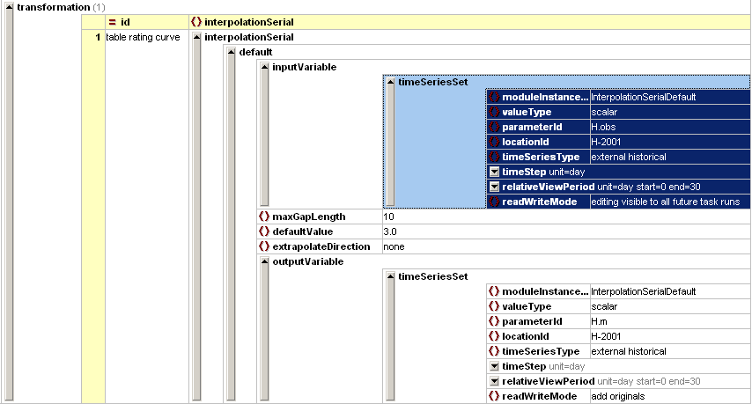
Transformation Module – Interpolation
Serial Interpolation methods
Default
Block
Linear
Extrapolation
Spatial Interpolation methods
Average
Bilinear
Closest distance
Inverse distance
Kriging
Max / min
Sum
Thiessen polygon
Triangulation
Weighted
7
Notes:
7

Slide 8
Exercise
Exercise 9: Fill gaps in imported timeseries
Analyse module that fills gaps in the water level time series
Add the new module instance to the module instance descriptors
Configure a workflow that executes the interpolation module instance
Check results!

Slide 9
Transformation Module - Interpolation
Possible problems / Issues to note
Time Series Set to Interpolate
ModuleInstanceId of series!!! (ImportTelemetry)
Relative View Period
When interpolating to fill gaps
Input time series same as output time series
Using LocationSets and/or Locations
Linear interpolation – can be done using a locationSet
Default – take care as default value may vary per location

Slide 10
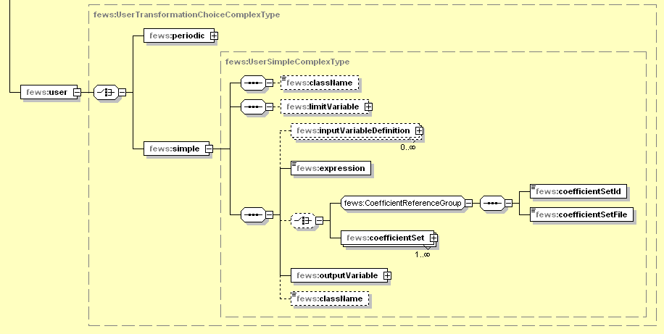
Transformation Module - Examples User defined function

Slide 11
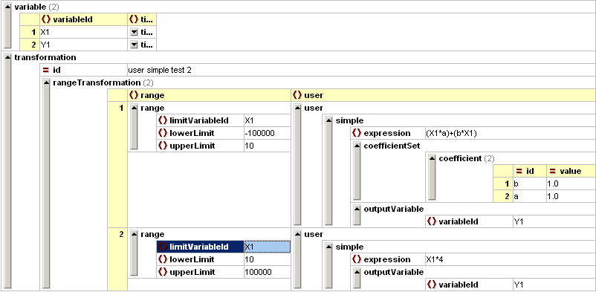
Transformation Module - Examples User defined function
Different function / parameters per segment / range
Define ranges in rating curves file / coefficientsets file

Slide 12
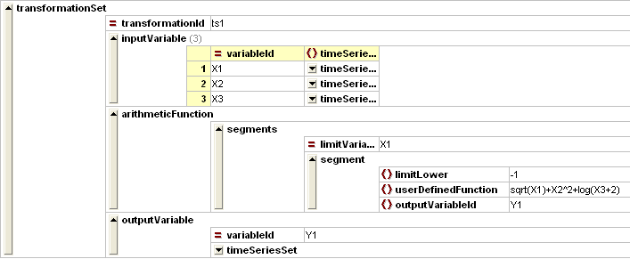
Transformation Module - Examples User defined function
Generic function parser used
“Any” function can be defined

Slide 13
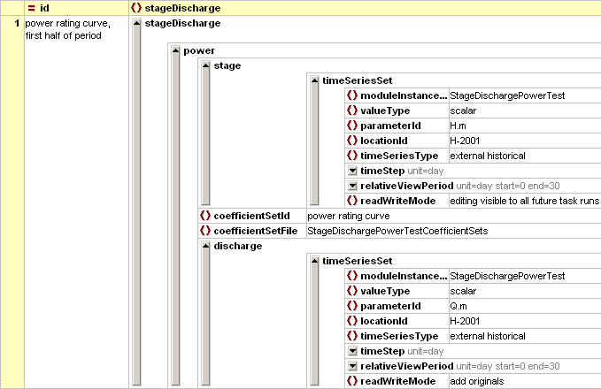
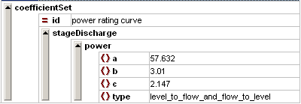
Transformation Module - Examples Rating curve
Same approach as other transformations using stageDischarge class
Convention on inputId / ouputId & parameter names
Rating curves are contained in the CoefficientSetFiles (RatingCurves.xml)
Rating curves are linked to locations
One location or locationSet
Use coefficients from CoefficientSetFile

Slide 14
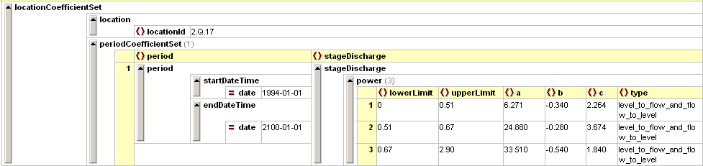
Transformation Module - Examples Rating curve
CoefficientSets
StageDischargeCoefficientSets.xml (name not fixed)
In CoefficientSetsFiles folder
Referenced in Transformation ModuleInstance
Rating curve defined only once
Referenced by locationId

Slide 15
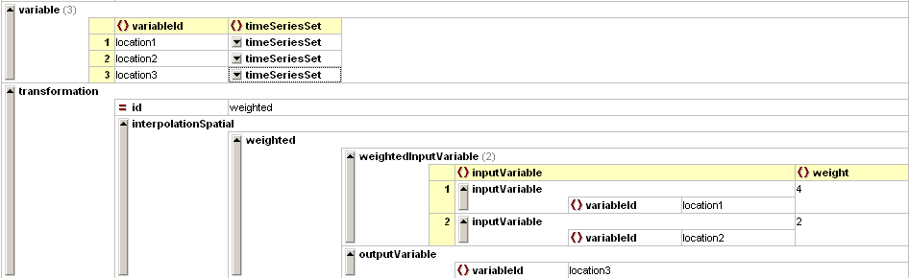
Transformation Module - Examples Weighted averaging
Convention on inputId / ouputId & parameter names
formula: (X1 * a + X2 * b + X3 * c) / (a + b + c)
number of locations is flexible, missing locations will be left out

Slide 16
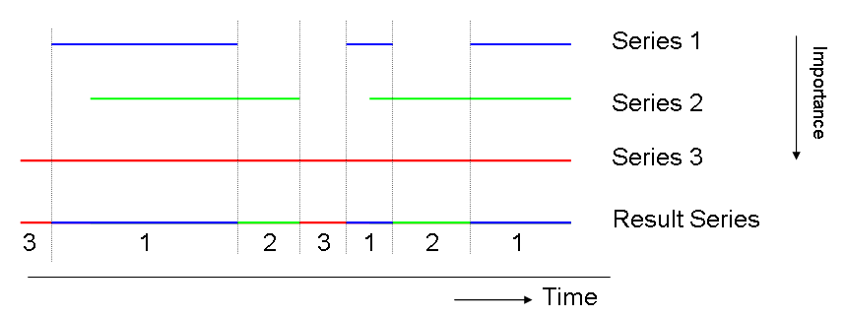
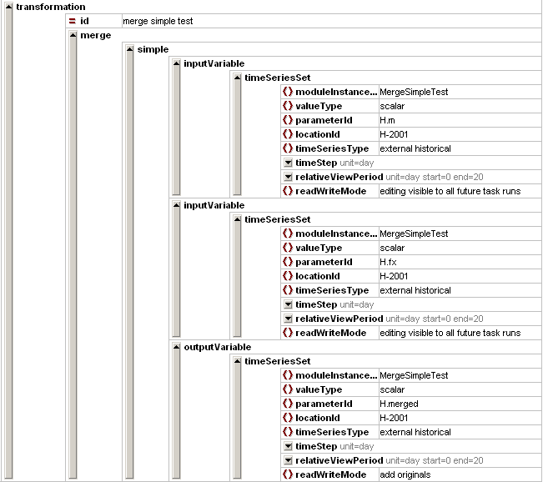
Transformation Module - Examples Data Hierarchy / Merge
Fallback options to complete a series
used first
used second
used third

Slide 17
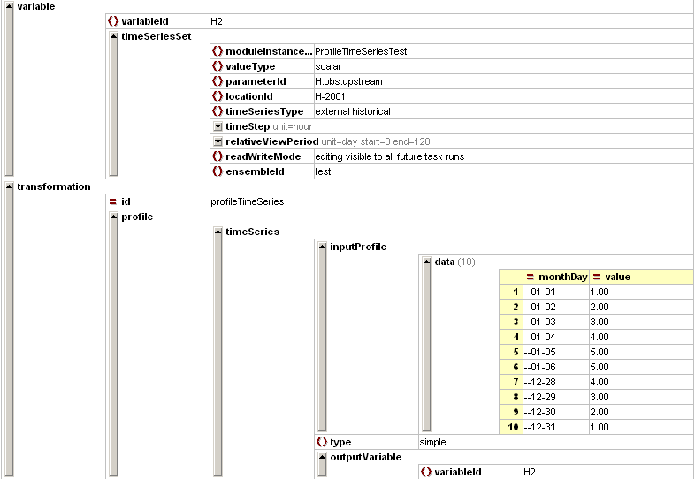
Transformation Module – Example Typical profile
Examples of typical profile use:
Evaporation series (one value per calendar day)
Temperature variation across day

Slide 18
Exercise
Exercise 10: Add rating curves
Add rating curve for location Hydro1
Analyse transformation file
register module instance in descriptors file
add module instance to the exercise workflow

Slide 19
Exercise
Exercise 11: Add catchment averaging rules
Averaging rainfall data from 2 locations into 1
create a new location
adding weights to (input) series to create new output series for this location
register module instance in descriptors file
add module instance to the exercise workflow

